Slide 1


CPS 109 Lab 6
Mojan Nooshin Habibi
Gurpreet Kaur

Slide 2


Agenda
Recursion Continued
Exception Handling
Quiz

Slide 3
Recursion
Covered by Mojan

Slide 4
Error Handling / Exception Handling
Exception Handling is the process of responding to unwanted or unexpected events when a computer program runs.
Exception handling deals with such events to avoid program/system crashing .
Without this EXCEPTION HANDLING process , exceptions might disrupt the normal operation of program.

Slide 5
Exceptions in Python
Python has many built-in exceptions that are raised when program encounters an error.
When these exceptions occur , the python interpreter stops the current process and passes it to the calling process util it is handled . If not handled , the program will crash

Slide 6
Python try..except
Try.. Except blocks are used in Python to handle errors and exceptions.
The code in try block runs when there is no error.
If the try block catches the error, then the except block is executed.

Slide 7
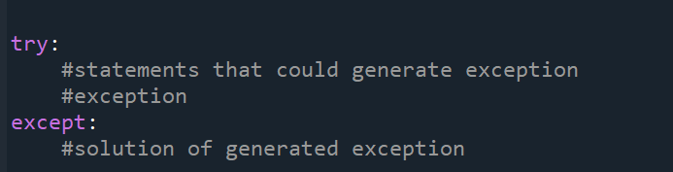
Syntax

Slide 8
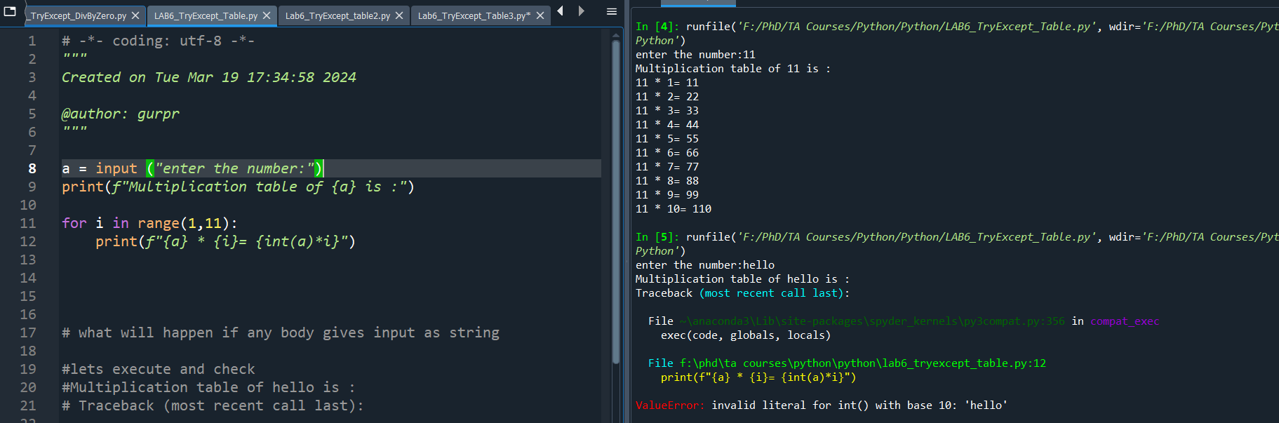

Example : TryExceptTable

Slide 9
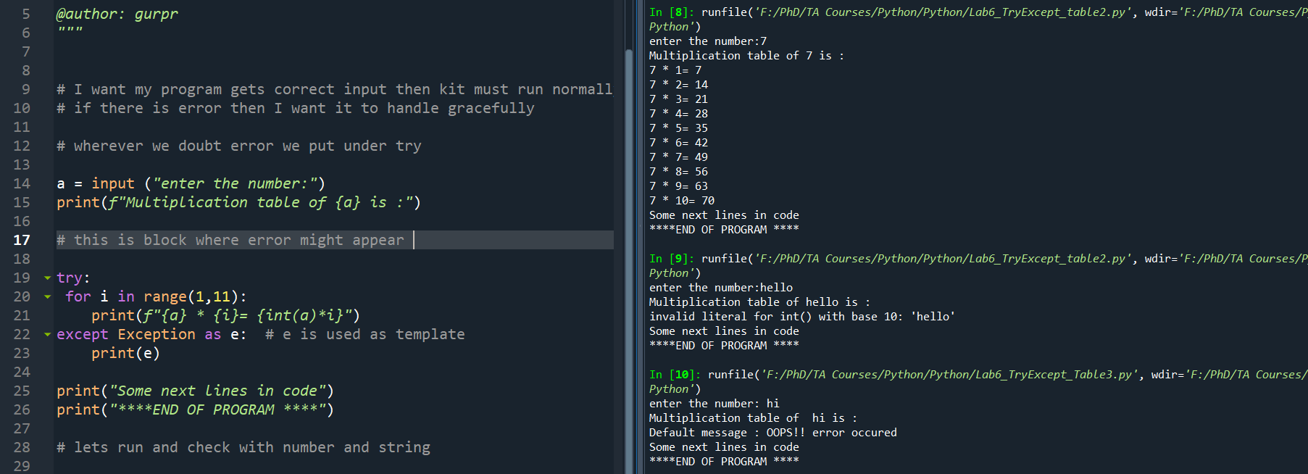
Example : TryExceptTable2.py

Slide 10
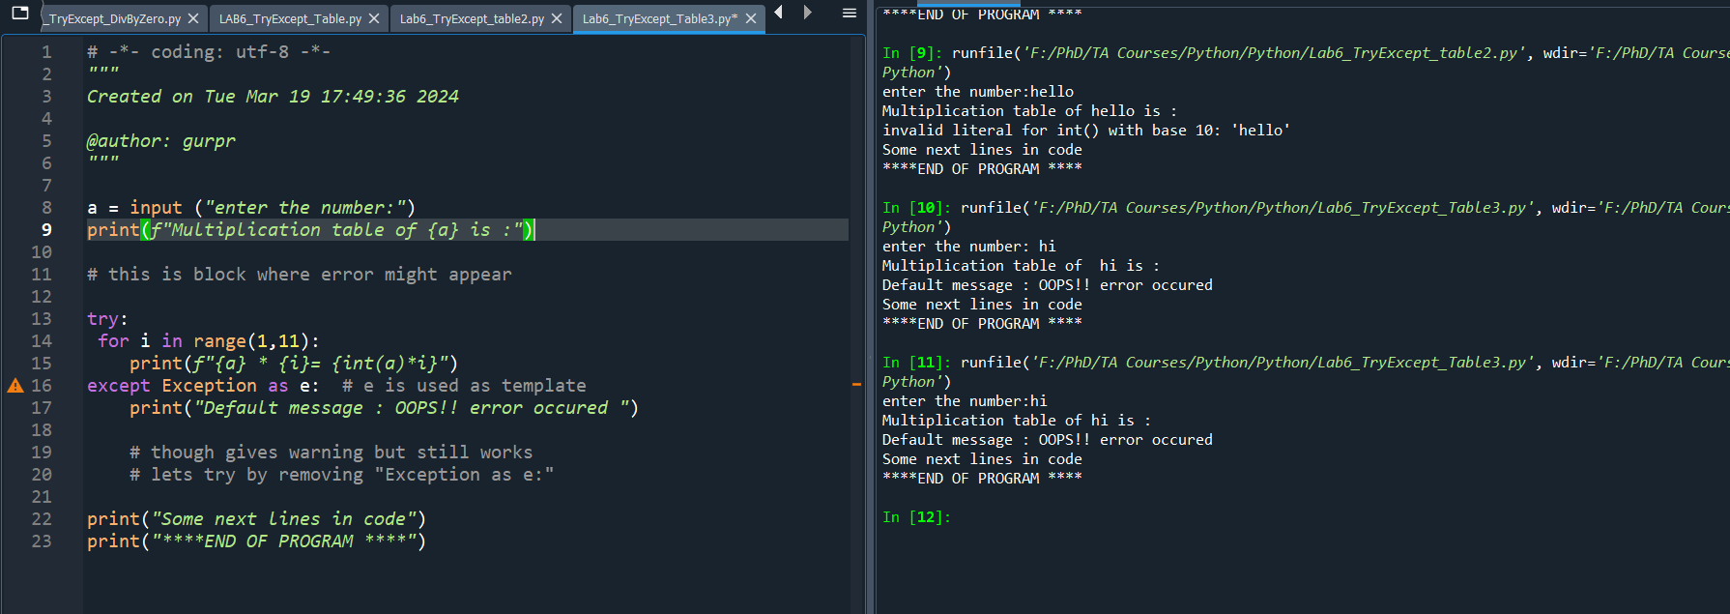
General question : Why e??: TryExcept_Table3.py

Slide 11
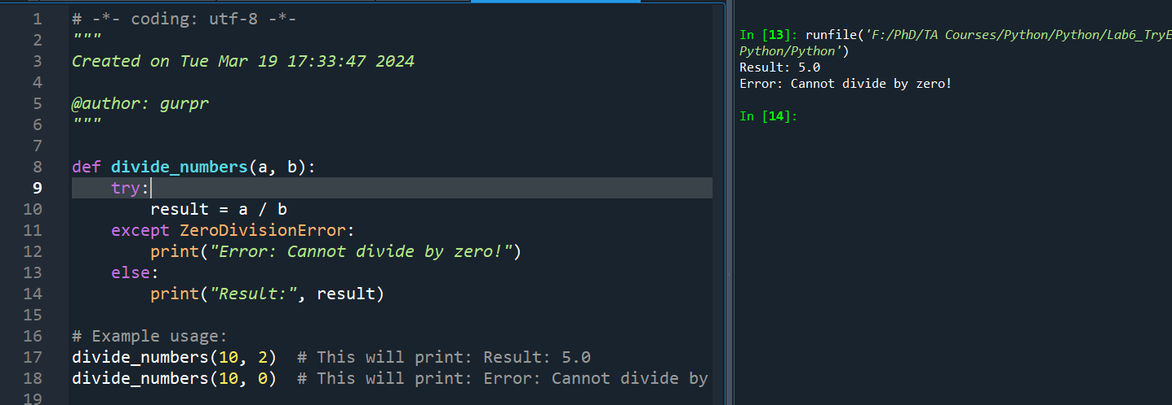
Example : TryExceptDivbyZero.py

Slide 12
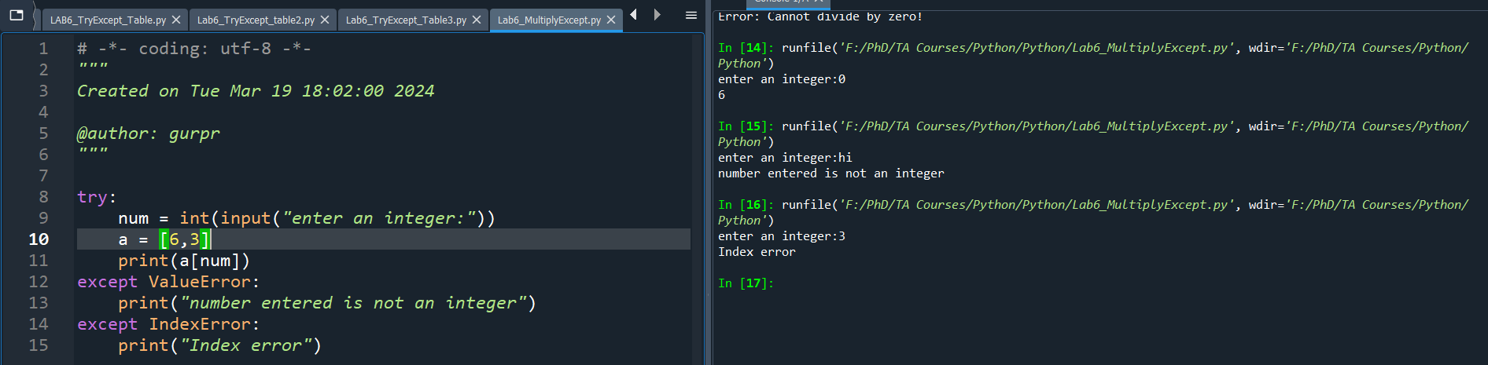
Multiple Exceptions

Slide 13

Exception classes . Covered later

Slide 14

Thanks !!
Any Questions ?

Slide 15
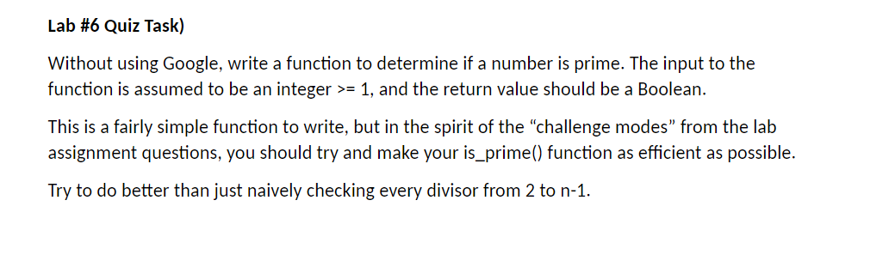
Quiz Time

